Slide 1
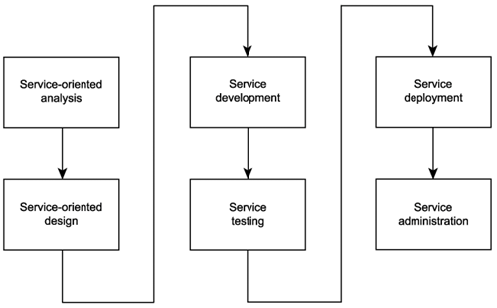
SOA delivery lifecycle

Slide 2
Service-oriented design
Service-oriented design is the process by which concrete physical service designs are derived from logical service candidates and then assembled into abstract compositions that implement a business process.

Slide 3
Analysis in this process
How can physical service interface definitions be derived from the service candidates modeled during the service-oriented analysis phase?
What SOA characteristics do we want to realize and support?
What industry standards and extensions will be required by our SOA to implement the planned service designs and SOA characteristics?

Slide 4
Objectives of service-oriented design
Determine the core set of architectural extensions.
Set the boundaries of the architecture.
Identify required design standards.
Define abstract service interface designs.
Identify potential service compositions.
Assess support for service-orientation principles.
Explore support for characteristics of contemporary SOA.

Slide 5
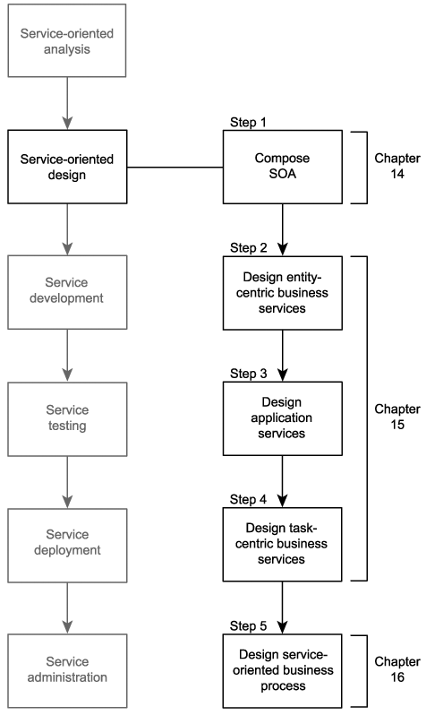

Slide 7
"WSDL first" Service Design
Before we can develop a service, we need to have defined the interface of that service - "WSDL first"
Defining the service interface prior to development is important to establishing a highly standardized service-oriented architecture and required to realize a number of the characteristics we identified as being part of contemporary SOA

Slide 8
Who should participate in this step?

Slide 9

Open Question
Points: 10
What kind of expertise is required to define the above documents?
Open Question is only supported on Version 2.0 or newer.
Answer

Slide 10
Who should participate in this step?
Best defined by those who understand the enterprise technical environments the most
Business analysis expertise not required

Slide 11
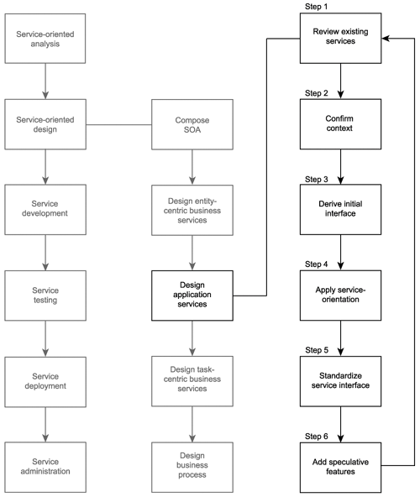
Service-oriented design
Design application services

Slide 12
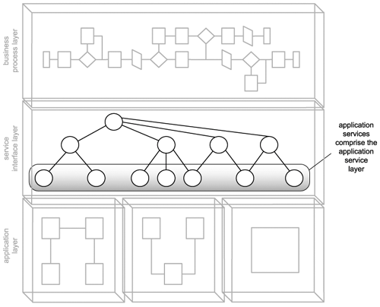
Design application services

Slide 13
The design of the Transform application service candidate

Slide 14
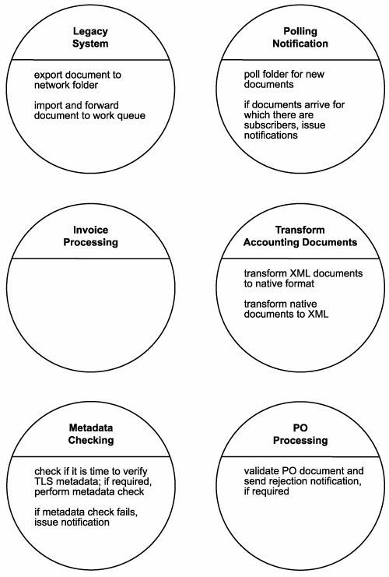
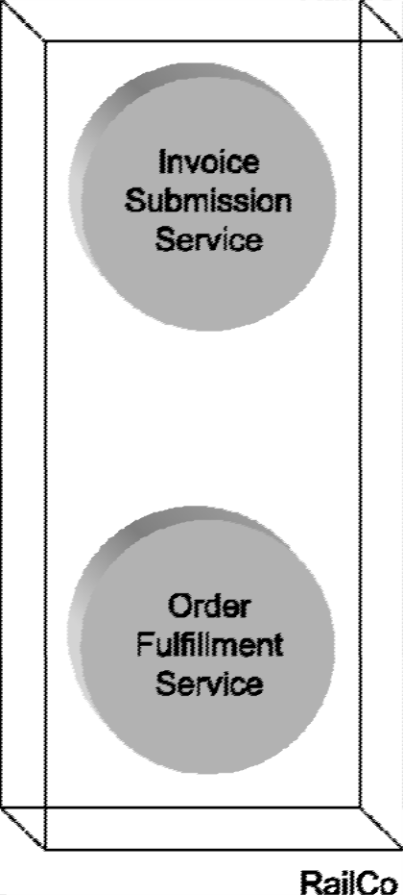
Recall RailCo’s service candidates
Old design
New service candidates

Slide 16
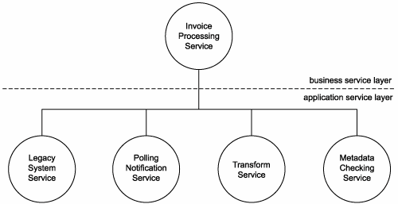
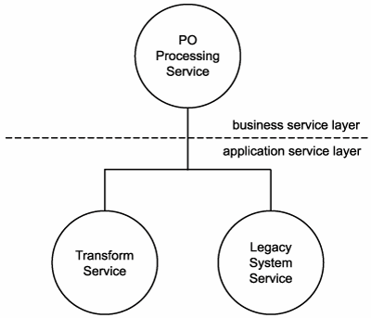
Recall RailCo’s service candidates
Old design
New service candidates

Slide 17
Transform Service

Slide 18
Transform Service

Slide 19
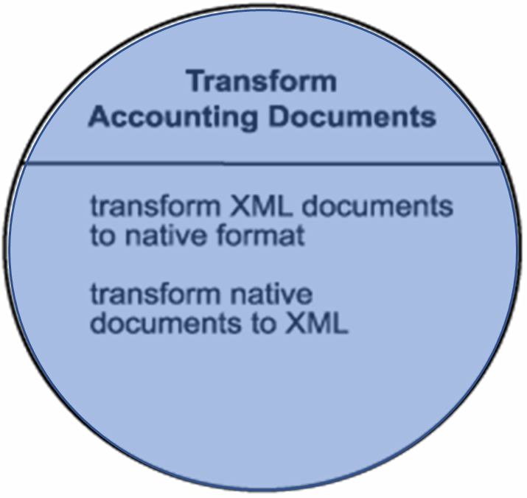
Transform Service

Slide 20
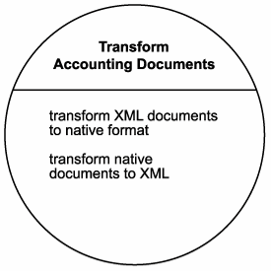
Service Design - Transform Service
This candidate establishes a "document transformation context," which justifies the grouping of its two very similar operation candidates:
transform XML documents to native format
transform native documents to XML

Slide 21
Today we will study some design decisions that RailCo has made when developing this service

Slide 22
Service-oriented design

Slide 23
Step 1: Review existing services
Check existing services for redundant features.
Check if the required feature can be purchased or leased from vendors.

Slide 24
Step 1: Review existing services
Check existing services for redundant features.
Check if the required feature can be purchased or leased from vendors.
Checking names, service descriptions and metadata of existing services (i.e. TLS Subscription Service), RailCo concludes that no overlap exists

Slide 25
Service-oriented design

Slide 26
Step 2: Confirm context
Reassess service context if operation candidate grouping from the analysis phase is appropriate, e.g. operations may better belong in other services.

Slide 27
Discussion
Why there is a need for the design phase to reassess what was already decided during the analysis phase?

Slide 28
What expertise is required?
Business
Technical

Slide 29
Step 2: Confirm context
Reassess service context if operation candidate grouping from the analysis phase is appropriate, e.g. operations may better belong in other services.
Review of Transform Accounting Documents service against TLS Subscription service confirms that grouping context is valid.

Slide 30
Service-oriented design

Slide 31
Step 3: Derive an initial service interface
Confirm that each operation candidate is suitably reusable and its granularity is appropriate.
Define definition of messages the service is to process (i.e. WSDL <types> area) using XML schema.
Establish a set of operation names and define WSDL <portType> with <operation>.
Define WSDL <message> with <part>.

Slide 32
Step 3: Derive an initial service interface
Define definition of messages the service is to process (i.e. WSDL <types> area) using XML schema.
Establish a set of operation names and define WSDL <portType> with <operation>.
Define WSDL <message> with <part>.

Slide 33
Activity
Let’s first brainstorm potential names for the operations of our service

Slide 34
Open Question
Points: 10
Currently the candidate service operations in the Transform Service are called
transform XML documents to native format
transform native documents to XML
Propose two names for the operations of our service that can be used in WSDL file.
The name should be as short as possible, yet descriptive enough to understand the function of the operation.
Open Question is only supported on Version 2.0 or newer.
Answer

Slide 35
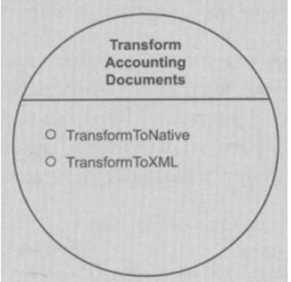
Confirm that each operation candidate is suitably reusable and its granularity is appropriate
RailCo begins by the two operation names shown here
It then moves on to define the types construct of its service definition to formalize the message structures

Slide 36
Define definition of messages the service is to process (i.e. WSDL <types> area) using XML schema

Slide 37
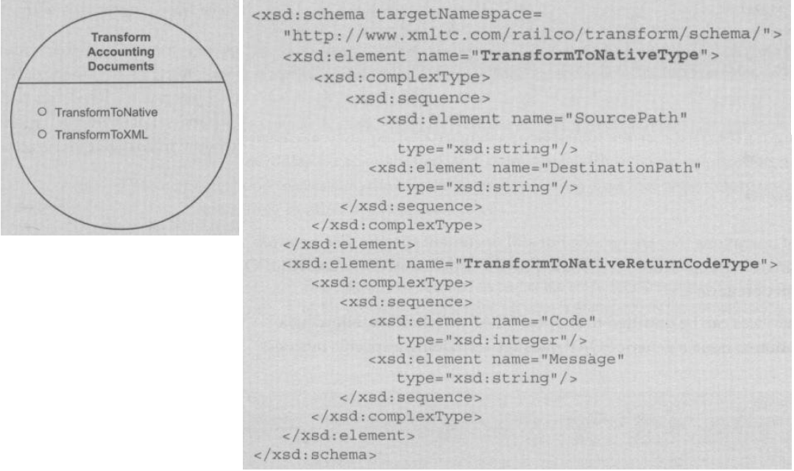
types for the TransformtoNative operation

Slide 38
Activity
We have designed the types for the TransformtoNative operation
The next step is to design the types for the TransformtoXML operation

Slide 39
Discussion
We observe, that the types for the second operation are the same as the first operation – in such case, the same schema for these two operations be shared?

Slide 40

Multiple Choice(single)
Points: 1
We observe, that the types for the second operation are the same as the first operation – in such case, the same schema for these two operations be shared?
A
YES
B
NO
提交

Slide 41
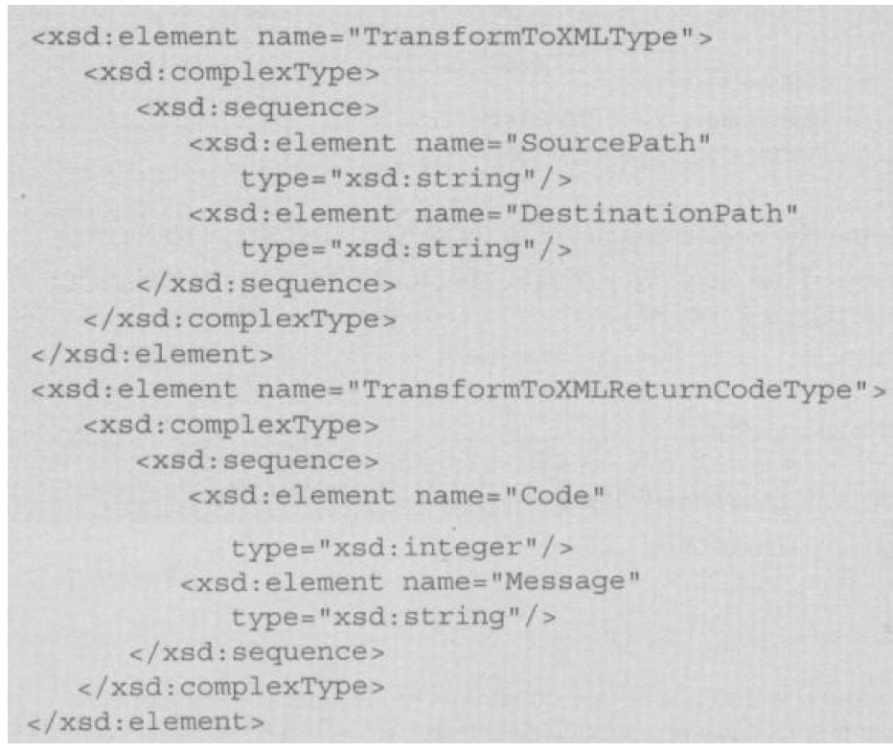
Types for TransformToXML are identical to those of TransformToNative and can be shared. But RailCo decides to keep a separate schema.
What is the benefit of this decision?

Slide 42
Open Question
Points: 10
Even though types for TransformToXML are identical to those of TransformToNative and can be shared, however RailCo decides to keep a separate schema.
What is the benefit of keeping these two schema in separate files?
Open Question is only supported on Version 2.0 or newer.
Answer

Slide 43
Types for TransformToXML are identical to those of TransformToNative and can be shared. But RailCo decides to keep a separate schema to have freedom to change them independently.

Slide 44
Define WSDL <message> with <part>

Slide 45
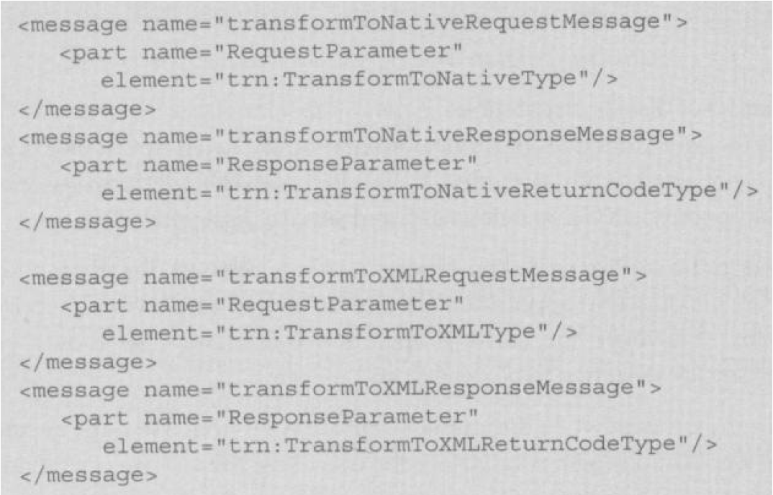
Define WSDL <message> with <part>

Slide 46
Establish a set of operation names and define WSDL <portType> with <operation>

Slide 47
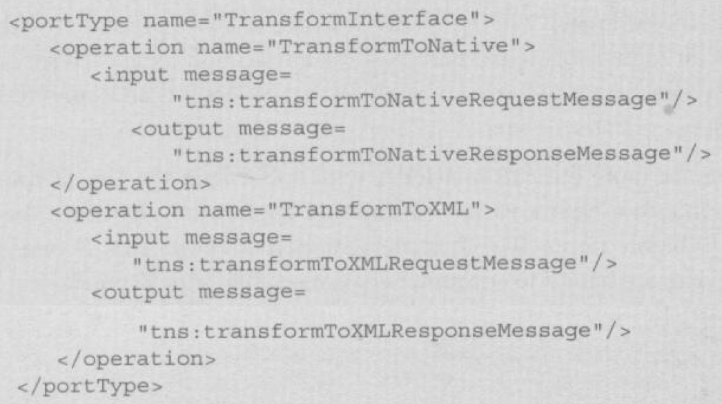
Establish a set of operation names and define WSDL <portType> with <operation>
Now the initial version of the abstract service definition for the RailCo Transform Account Document Service is completed

Slide 48
Service-oriented design

Slide 49
Step 4: Apply service-orientation
Revisit reusability, autonomy, statelessness, discoverability

Slide 50
Discussion
Service orientation was already applied during the analysis phase. Why do we need to do it again?

Slide 51
Open Question
Points: 10
Service orientation was already applied during the analysis phase. Why do we need to do it again?
Experts from different domains participate in these two phases
service oriented analysis: experts with business expertise participate in making decisions; decisions are made to fulfill business requirements;
service oriented design: experts who understand the enterprise technical environments make sure that the design meets technical requirements
Open Question is only supported on Version 2.0 or newer.
Answer

Slide 52
Activity
To provide higher reuse potential - could we combine the two operations TransformToNative and TransformToXML?

Slide 53
Multiple Choice(single)
Points: 1
To provide higher reuse potential - could we combine the two operations TransformToNative and TransformToXML?
A
Yes, combining these two operations will make them more generic and possible to reuse in more situations
B
No, there is no benefit from combining these two operations
Combining the two operations into one will make it more reusable … but there is a trade-off … we will lose freedom to evolve each of them separately
Submit

Slide 54
Step 4: Apply service-orientation
Revisit reusability, autonomy, statelessness, discoverability
Reuse potential - the two operations TransformToNative and TransformToXML are discussed to be combined into one generic operation. But RailCo decides to keep them both for the descriptive nature of the operations and freedom to evolve each of them separately
Autonomy and statelessness - no problem as the logic required to carry out the transformation is contained within the particular underlying application logic
Discoverability - metadata are added

Slide 55
Service definition is outfitted with additional metadata documentation (check chapter 15.5 for service design guidelines)

Slide 56
Service-oriented design

Slide 57
Step 5: Standardize service interface
Apply appropriately any existing design standards and guidelines.
E.g. naming convention: Names should be generic for high reuse potential and clearly communicate the processing context (verb+noun or noun).
Consider quality of service design, e.g. extensibility.

Slide 58
Step 5: Standardize service interface
RailCo thinks service and operation names are already appropriate. However, the names are changed for future extensibility. The service becomes a transformation utility that can be extended in the future to offer other transformation related features (not only for use by an accounting system).

Slide 61
Service-oriented design

Slide 62
Step 6: Add speculative features
Perform speculative analysis as to what other processing falls within the service context.
Repeat steps 1-5.
RailCo cannot afford any extension at this time. But the design of Transform service already gives future reusability opportunity.

Slide 63
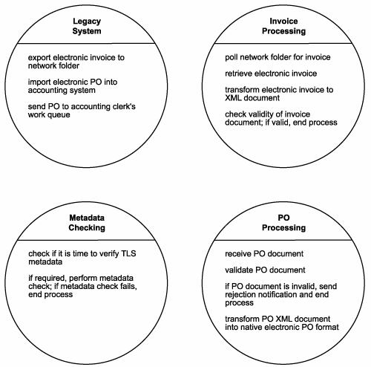
From service candidates to refined service candidates during service analysis

Slide 64
Further refinements during service design

Slide 65
Service design
In this phase, we got our abstract part of WSDL, we still need to design a full WSDL

Slide 66
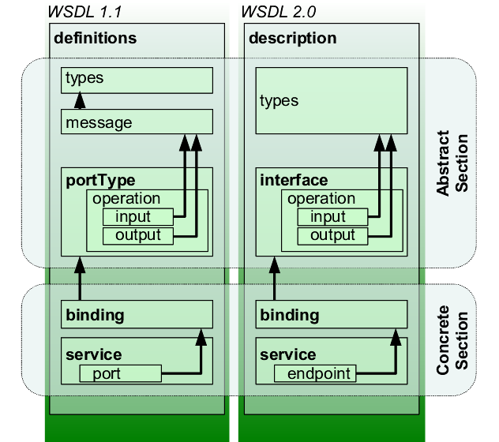

Slide 67
Service design
What happens after service design, what is the next step in SOA delivery lifecycle?

